Slide 1

AI-Powered Personal Tutor Intel® Unnati Industrial Training 2025
Team Members:
Team Lead: Chukka Prasadu
Members:
Bogyam Jagadeesh
Ghantasala V N L S Satya Ganesh
Mentor: Mr. G.Jeevana Manikanta

Slide 2
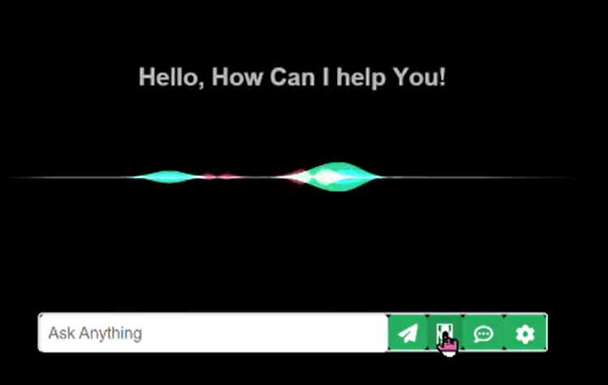
PROBLEM STATEMENT
Problem Statement: Traditional learning platforms often lack personalization, leading to reduced student engagement and suboptimal learning outcomes.
Objectives:
Deliver a customized learning experience.
Monitor and analyze student performance.
Recommend adaptive content in real-time.
Provide voice/text-based assistance.

Slide 3
Proposed Solution Overview: An AI-powered tutor that adapts to user learning patterns, providing real-time suggestions, personalized paths, and a smart dashboard.
Core Features: User Authentication Pre-Assessment Evaluation Adaptive Learning Path Real-Time Performance Tracking AI-Based Content Recommendation Interactive Doubt Assistance Notes Management System Rating & Feedback System Module-Wise Promotions

Slide 4
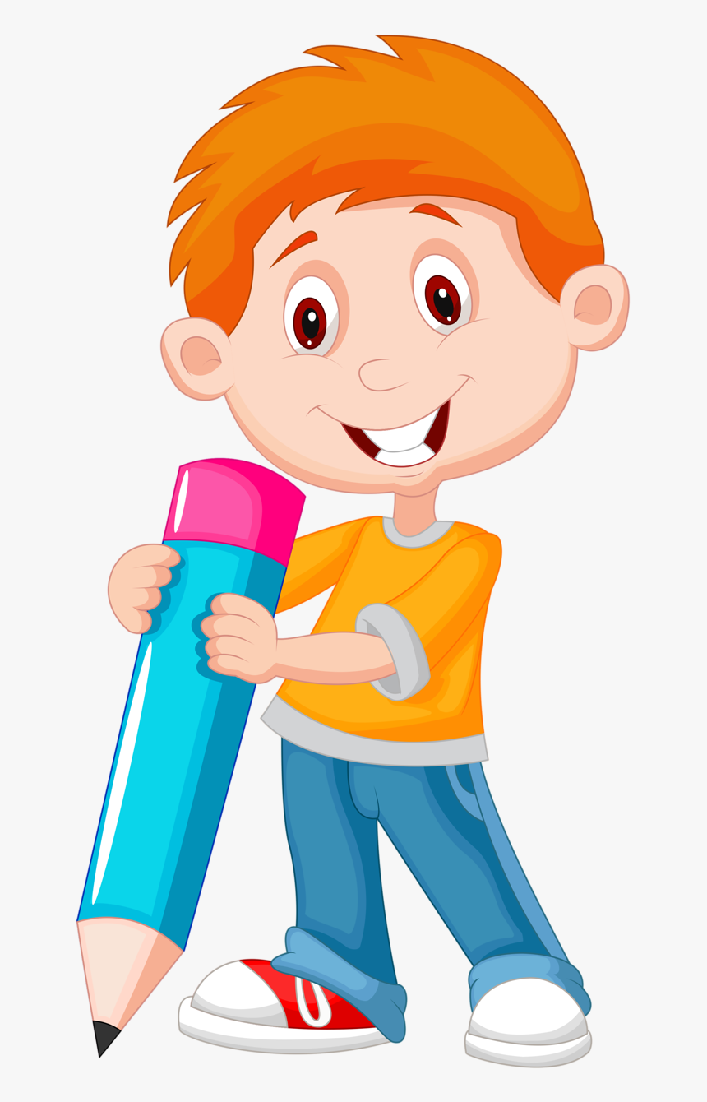
System Architecture & Tech Stack
System Architecture: Runs locally using Flask with modular AI components for learning analysis and content recommendation.
Tech Stack:
Frontend: HTML, CSS, JavaScript, jQuery, Textillate.js
Backend: Python, Flask
Database: MySQL
AI/ML: OpenAI API, Scikit-learn, HugChat
Voice & Speech: pyttsx3, speech_recognition
Security: bcrypt, .env config

Slide 5
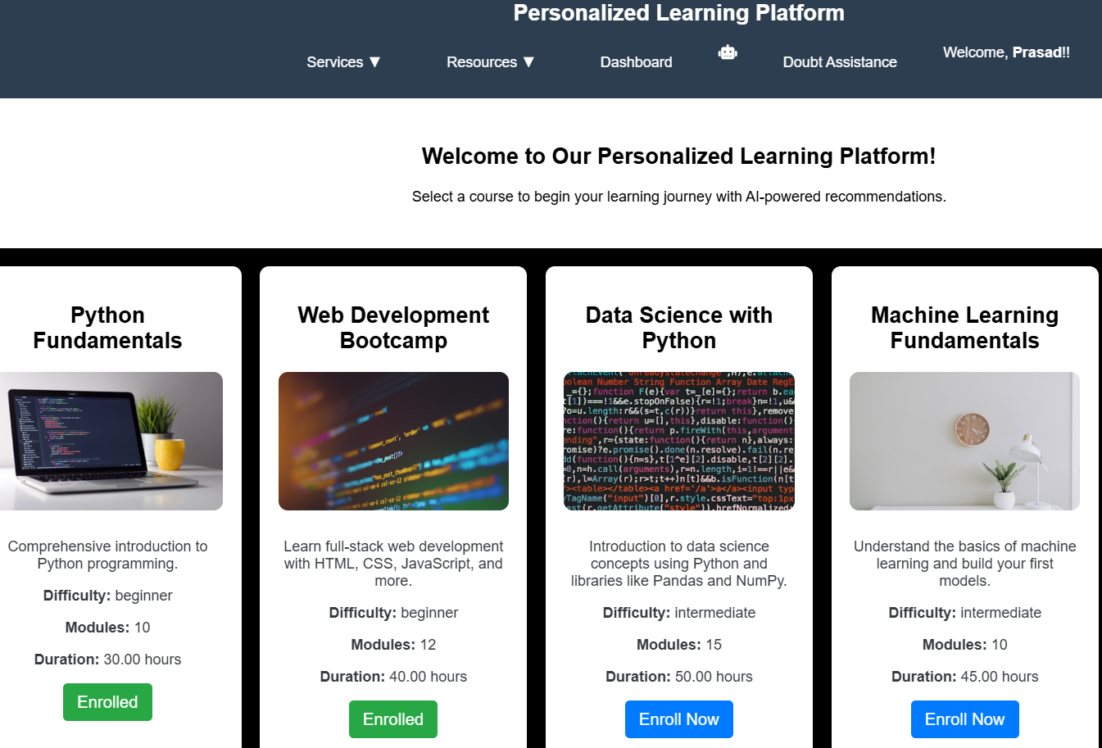
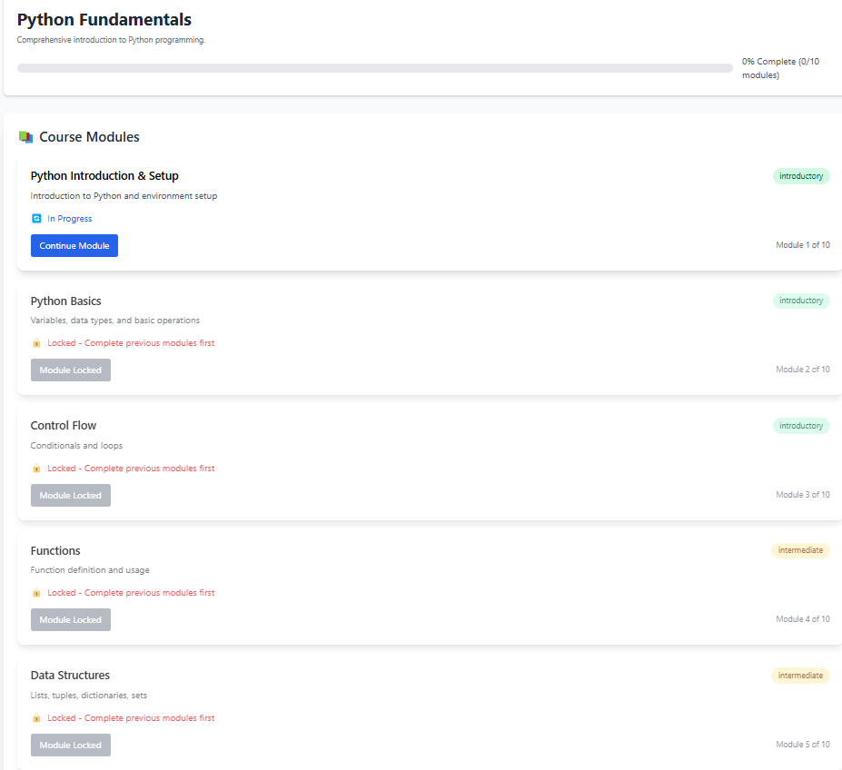

Implementation & Results
Implementation Highlights:
Flask backend integrated with AI modules
Custom dashboard with login system
Real-time speech-to-text assistant
Rating and notes system for feedback
Results:
Personalized learning paths
Improved engagement
Smart content delivery based on needs

Slide 6
Thank you
.
.

